Slide 1
LISTERIOSIS
DISEASE
Here is where your presentation begins

Slide 2
CONTENTS OF THIS TEMPLATE
Here’s what you’ll find in this Slidesgo template:
A slide structure based on a Disease presentation, which you can easily adapt to your needs. For more info on how to edit the template, please visit our blog or read our FAQs.
An assortment of graphic resources that are suitable for use in the presentation can be found in the alternative resources slide.
A thanks slide, which you must keep so that proper credits for our design are given.
A resources slide, where you’ll find links to all the elements used in the template.
Instructions for use.
Final slides with:
The fonts and colors used in the template.
A selection of illustrations. You can also customize and animate them as you wish with the online editor. Visit Storyset to find more.
More infographic resources, whose size and color can be edited.
Sets of customizable icons of the following themes: general, business, avatar, creative process, education, help & support, medical, nature, performing arts, SEO & marketing, and teamwork.
You can delete this slide when you’re done editing the presentation.

Slide 3
TABLE OF CONTENTS
01
02
ABOUT THE DISEASE
DIAGNOSIS
03
04
RECOMMENDATION
PATHOLOGY
You can describe the topic of the section here
You can describe the topic of the section here
You can describe the topic of the section here
You can describe the topic of the section here

Slide 4
01
ABOUT THE DISEASE
You can describe the topic of the section here

Slide 5
— SOMEONE FAMOUS
“This is a quote, words full of wisdom that someone important said and can make the reader get inspired.”

Slide 6
INTRODUCTION
Listeriosis, which is caused by eating food contaminated by the bacteria Listeria monocytogenes, can be a serious disease. In the United States, an estimated 1,850 persons become seriously ill with listeriosis each year. In Illinois, approximately 20 cases of listeriosis are reported annually; about 25 percent of the patients die

Slide 7
THREE FACTS ABOUT LISTERIOSIS
MARS
MERCURY
Neptune
Despite being red, Mars is a cold planet. It’s full of oxide dust
Mercury is the closest planet to the Sun and a very small one
Neptune is an ice giant and the farthest planet in the Solar System

Slide 8
CONCEPT AND TYPOLOGY
CONCEPT
TYPE A
TYPE B
Mercury is the closest planet to the Sun and the smallest one in the Solar System. This planet's name has nothing to do with the liquid metal, since Mercury was named after the Roman messenger god
Venus has a beautiful name and is the second planet from the Sun. It has high temperatures
Despite being red, Mars is actually a cold place. It’s full of iron oxide dust

Slide 9
AWESOME WORDS

Slide 10
LISTERIA’S PATHOLOGY
MUSCLE PAIN
DIARRHEA
FEVER
CONFUSION
Despite being red, Mars is a very cold planet
Neptune is the farthest planet of them all
Mercury is the closest planet to the Sun
Venus has a nice name and a toxic atmosphere

Slide 11
SYMPTOMS OF THE LISTERIA
MUSCLE PAIN
DIARRHEA
FEVER
CONFUSION
HEADACHE
RIGIDITY
Despite being red, Mars is a very cold planet
Neptune is the farthest planet of them all
Earth is the planet where we all live
Venus has a nice name and a toxic atmosphere
Saturn is a gas giant with several rings
Jupiter is the biggest planet of them all

Slide 12
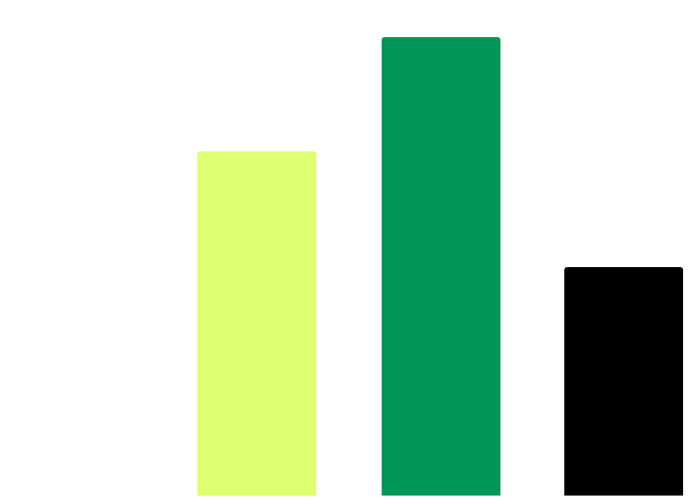
RISKS FACTORS
30%
40%
Jupiter
Saturn
Jupiter is a very big planet
Saturn is a gas giant with rings
10%
20%
MARS
To modify this graph, click on it, follow the link, change the data and paste the new graph here, replacing this one. You can see how to modify the graph here
VENUS
Despite being red, Mars is cold
Venus has a toxic atmosphere

Slide 13
150,000
30,000
6,000
Mercury is the closest planet to the Sun and the smallest one of them all
Venus has a beautiful name and is the second planet from the Sun
Earth is the third planet from the Sun and the only one that harbors life

Slide 14
LISTERIOSIS DIAGNOSIS
MARS
VENUS
Despite being red, Mars is a cold planet, not hot
Venus has a beautiful name and a very toxic atmosphere

Slide 15
LISTERIOSIS PREVENTION
MERCURY
VENUS
MARS
Mercury is the closest planet to the Sun and the smallest one in the entire Solar System
Venus has a beautiful name and is the second planet from the Sun. It has a toxic atmosphere
Despite being red, Mars is actually a cold place. It’s full of iron oxide dust

Slide 16
LISTERIOSIS TREATMENT
STEP 1
STEP 2
STEP 3
STEP 4
Mercury is the closest planet to the Sun
Despite being red Mars is actually a cold place
Jupiter is the biggest planet of them all
Venus has a beautiful name and a toxic atmosphere

Slide 17
RECOMMENDATIONS
Write a recommendation and description here
Write a recommendation and description here
Write a recommendation and description here
Write a recommendation and description here
Write a recommendation and description here
Write a recommendation and description here
Write a recommendation and description here
Write a recommendation and description here
Write a recommendation and description here
Write a recommendation and description here
Write a recommendation and description here
Write a recommendation and description here

Slide 18
LISTERIOSIS PREVALENCE
JUPITER
It’s the biggest planet of them all
NEPTUNE
Neptune is very far away from all of us

Slide 19
THIS IS A TABLE
PATIENT | MEDICAL TESTS | TREATMENT | TRACING
Asymptomatic | No | No | Mercury is a very small planet
No risk factors | Yes | No | Despite being red, Mars is cold
Mild risk factors | Yes | Yes | Jupiter is a very big planet
High risk factors | No | Ampi IV 2g/6h+- genta | Venus has a very toxic atmosphere

Slide 20
CONCLUSIONS
Jupiter is a gas giant and the biggest planet in the Solar System. It's the fourth-brightest object in the night sky. It was named after the Roman god of the skies and lightning

Slide 21

MOCKUP
You can replace the image on the screen with your own work. Just right-click on it and select “Replace image”

Slide 22
REFERENCES
AUTHOR (YEAR). Title of the publication. Publisher
AUTHOR (YEAR). Title of the publication. Publisher
AUTHOR (YEAR). Title of the publication. Publisher
AUTHOR (YEAR). Title of the publication. Publisher
AUTHOR (YEAR). Title of the publication. Publisher
AUTHOR (YEAR). Title of the publication. Publisher
AUTHOR (YEAR). Title of the publication. Publisher

Slide 23
THANKS!
Do you have any questions?
youremail@freepik.com
+91 620 421 838
yourwebsite.com
Please keep this slide for attribution

